Slide 1
Laws
Of thermodynamics not legal I don’t know any lawyer stuff

Slide 2
Zeroth law

Slide 3
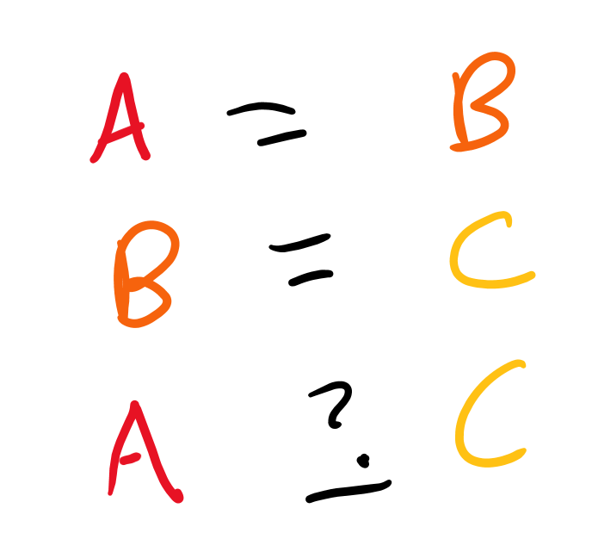
Transitive property in math
If A = B and B = C, what do we know about A and C?
For example, if we know Andrew and Bikrant have the same number of brain cells, and we know Bikrant and Csam have the same amount of brain cells, how do the brain cells of Andrew and Csam compare?

Slide 4
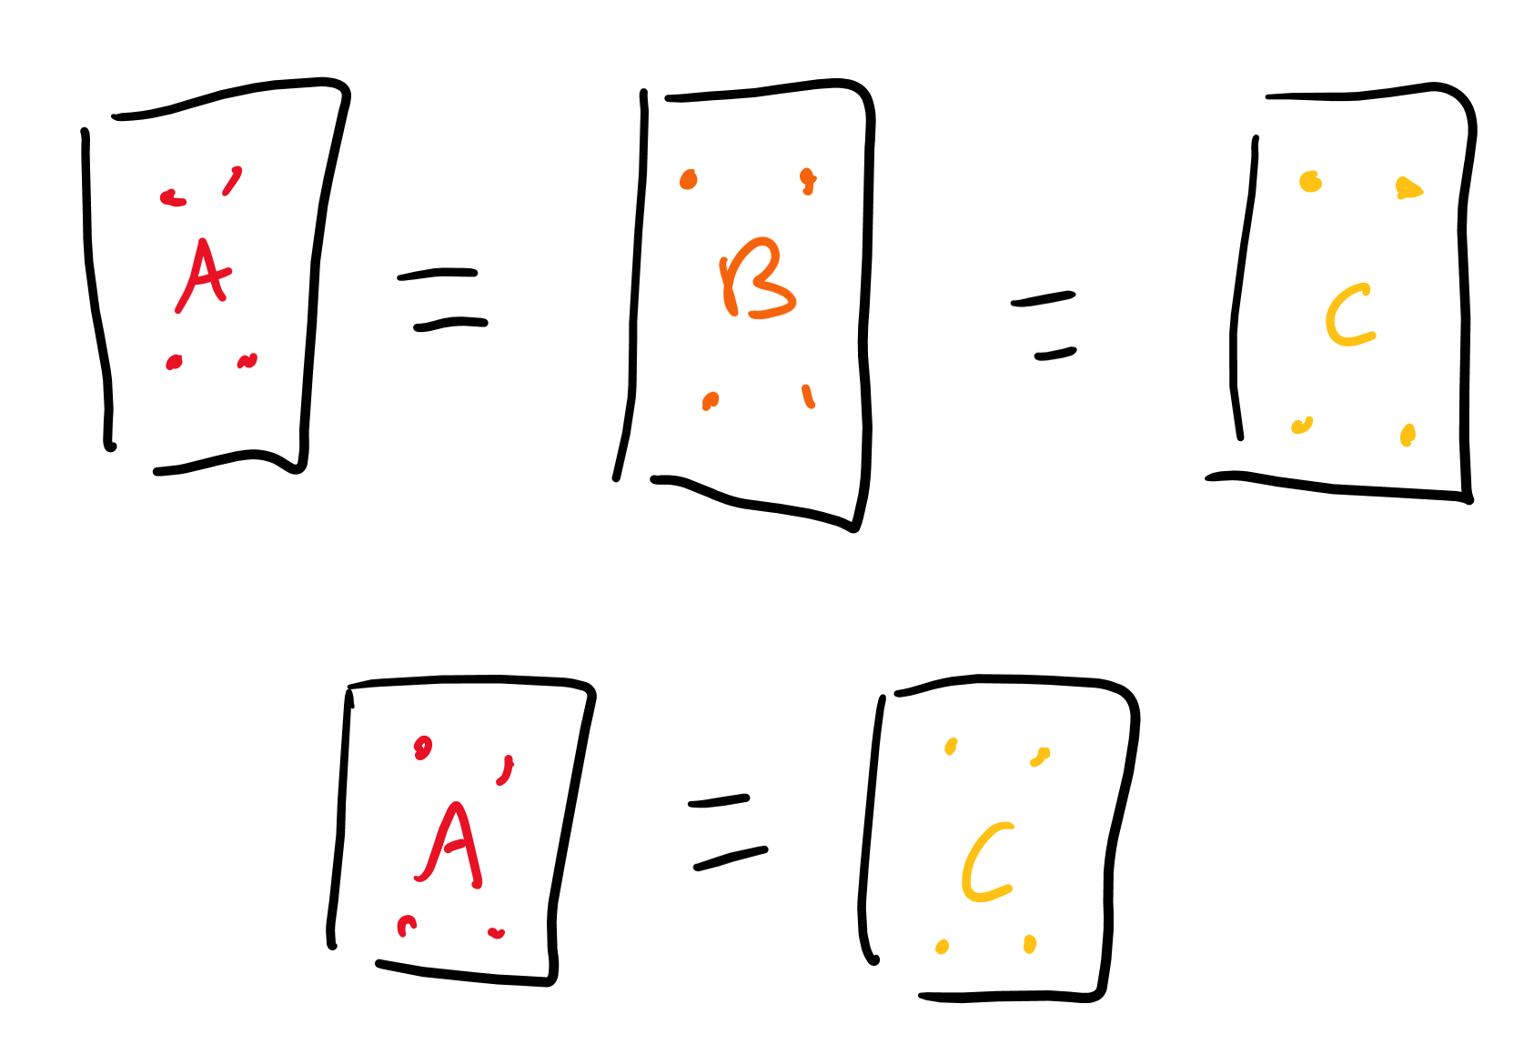
Transitive property in thermo
If we have a “system” of particles at equilibrium (not moving) A which is the same as B, and a system B which is the same as C, then the system A and C are the same.

Slide 5
How to remember?
Takes 0 brain cells to come up with 0th law, very easy conceptually.

Slide 6
First law (important one)

Slide 7
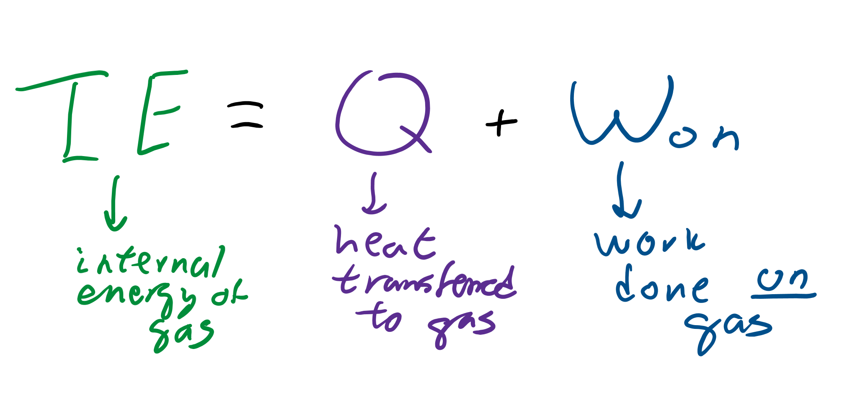
Internal energy equation
What were the two things that affected internal energy?
If you increase heat what happens to internal energy?
If you do work on a gas what happens to internal energy?
The equation for internal energy is actually the first law!

Slide 8
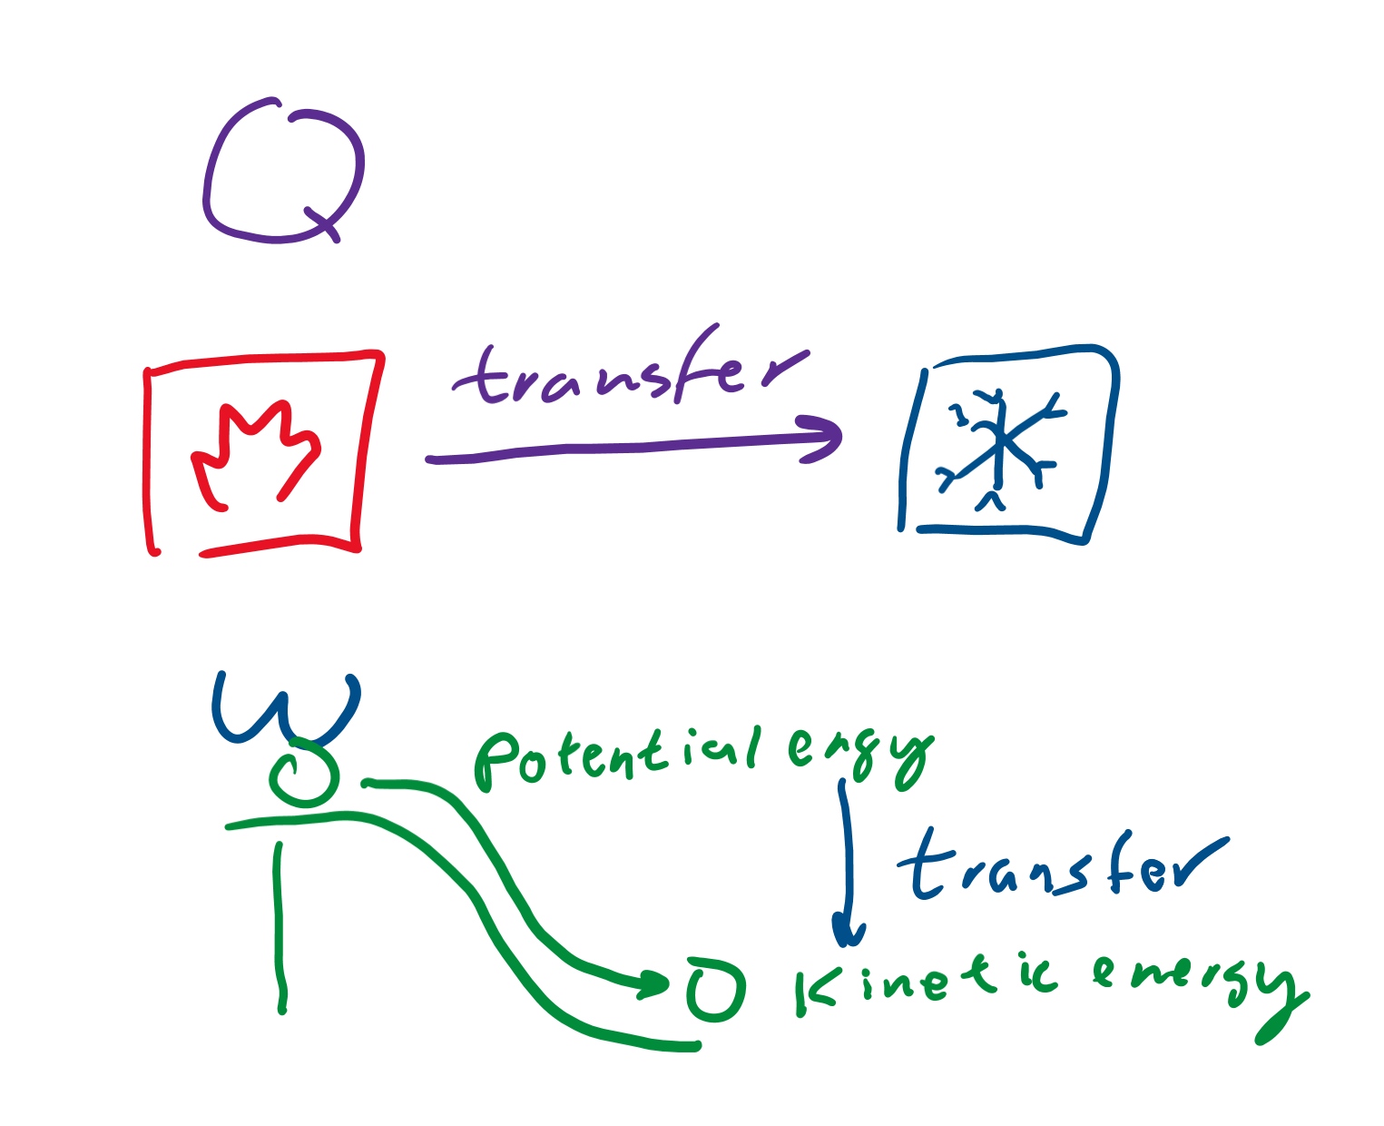
What are work and heat?
Heat is thermal energy that’s transferred from one object to another.
Work is using energy to increase the energy of something else.
Either way, there is a transfer of energy!

Slide 9
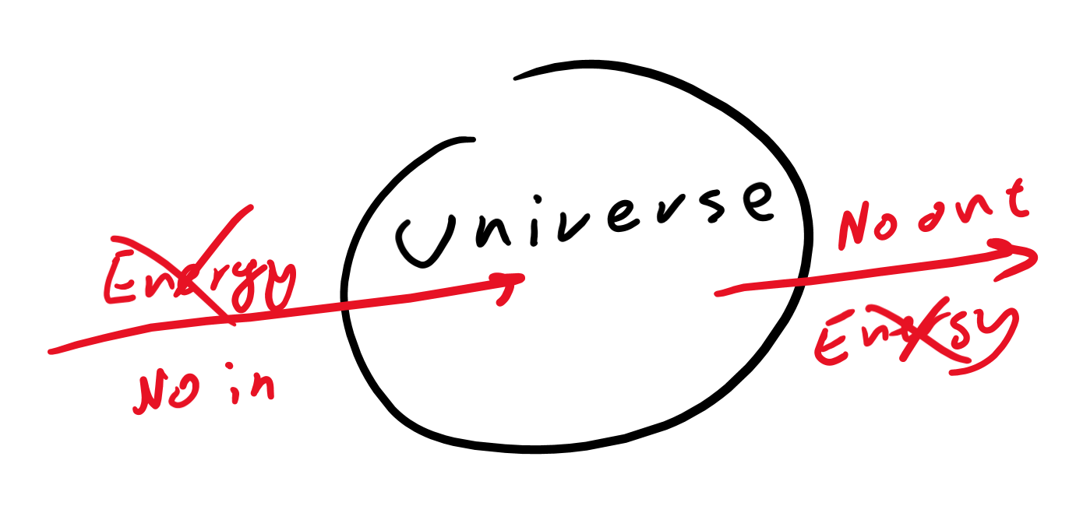
What that means
Energy is transferred.
The only way to increase the energy of one thing is to transfer it from somewhere else.
You can’t make energy without taking, you can’t take without making.
The total amount of energy in the universe is conserved.

Slide 10
Second law (important one version two)

Slide 11

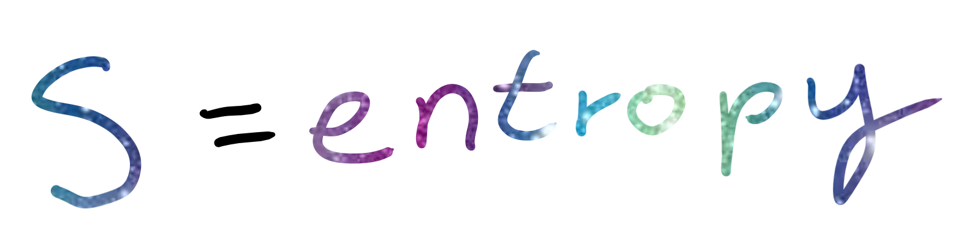
Disorder
The amount of chaos in the universe is called “entropy”
That’s how we measure disorder
Technical definition: a measure proportional to the number of microstates existent (aka, the more chaotic it can be, the more entropy exists)

Slide 12
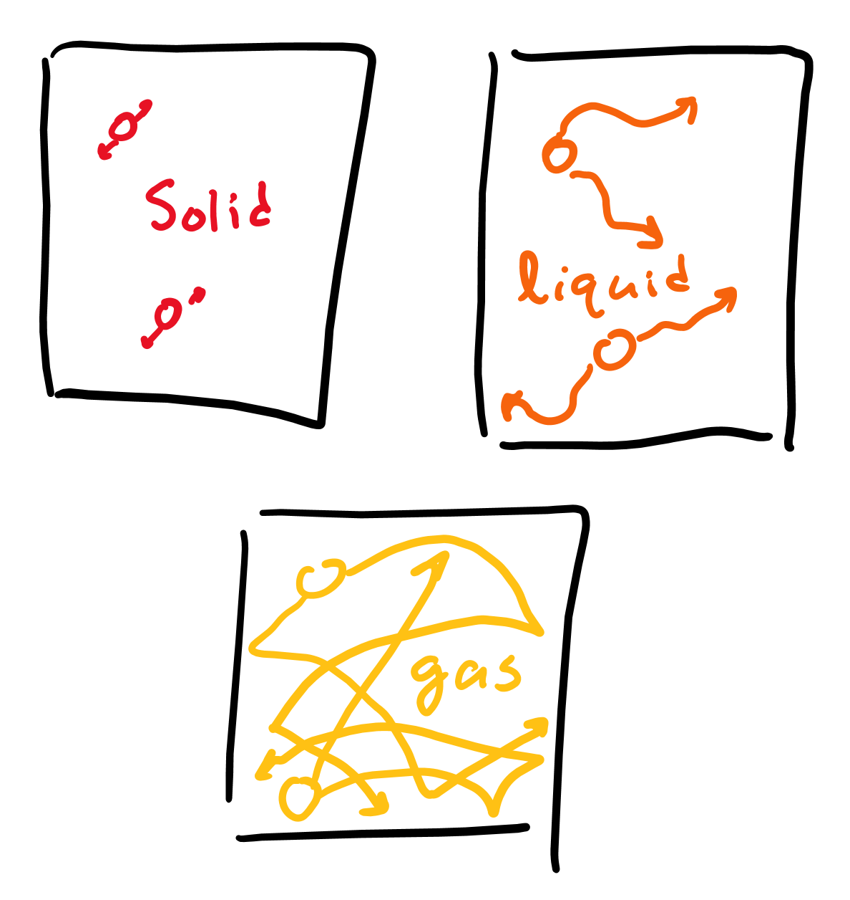
States of matter
Solids are very orderly: have fixed shape and volume
Liquids are less orderly: have no fixed shape (can flow from one container to another and change shape) but has fixed volume (one glass of water is equal to one glass of water)
Gasses are very disorderly: no fixed shape or volume (expand to fit container)

Slide 13
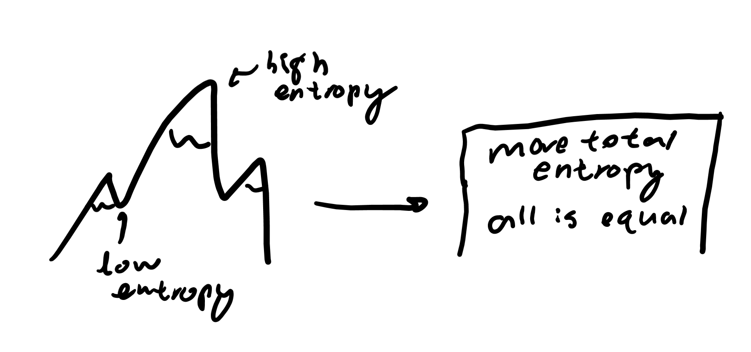
So what?
Well, entropy always increases
To form a solid, you have to remove heat from a liquid, putting more heat energy into the universe and making more disorder
The universe also seeks to balance: that means there will no longer be order and everything will eventually fall into chaos

Slide 14
Third law

Slide 15
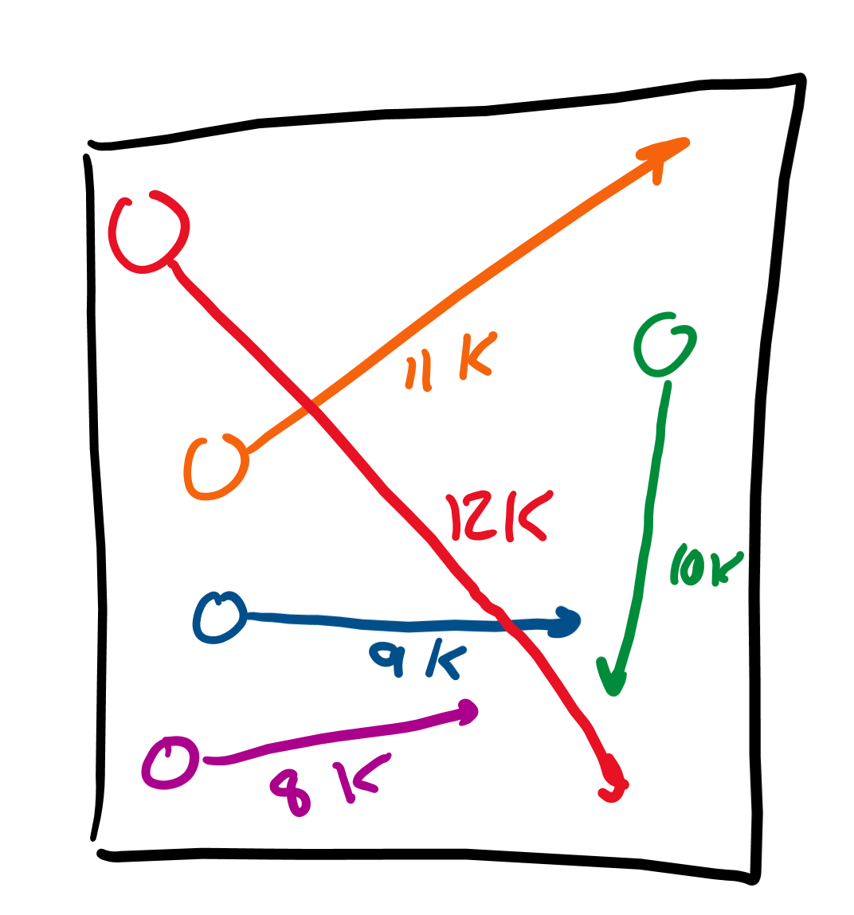
Question
If the temperature of a sample with 5 particles is 10 Kelvin, do we know the temperature of each particle?
Well, no, temperature is average kinetic energy, so we could have 8K, 9K, 10K, 11K, and 12K as the temps of each particle to get the temperature of the sample to be 10K.

Slide 16

Absolute zero!
This is when the average kinetic energy is zero.
No particles move.
Everything is stationary.

Slide 17

New question
If the temperature is 0 K, do we know the temperatures of each particle?
Yes! Each particle is 0 K as well because the temperature can’t be negative (below 0 K, or absolute zero)

Slide 18
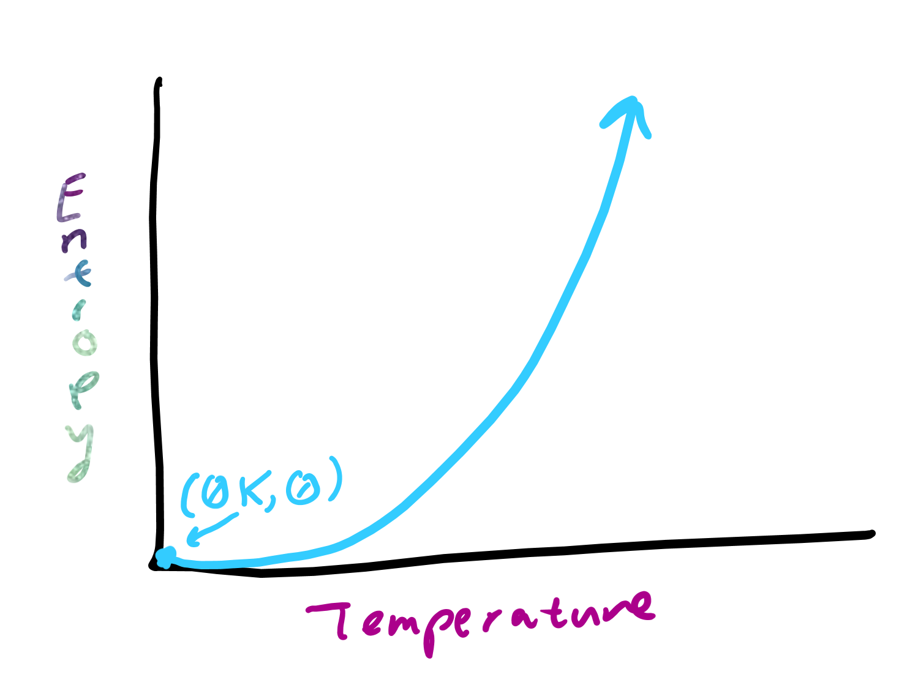
Third law
At absolute zero nothing is moving.
Thus, there is only one state the sample can be in, no motion will occur.
There is no chaos, everything is orderly.
Thus, entropy is zero at absolute zero.
As temperature increases, so does entropy.

